Slide 1
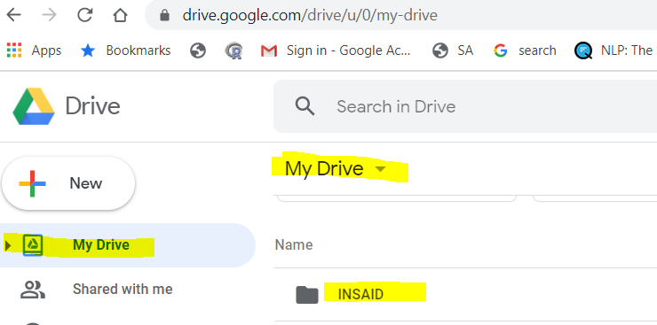
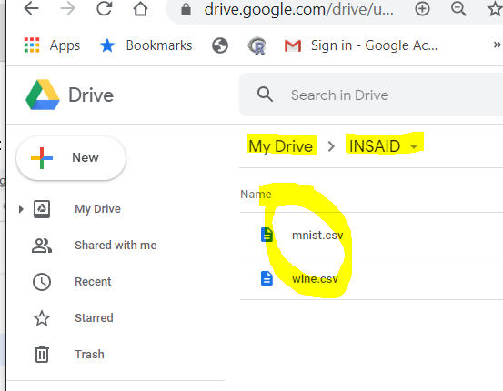
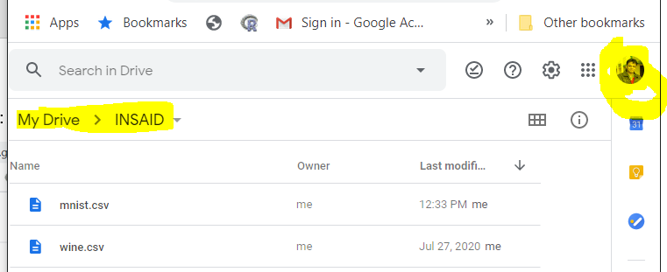
Go to Google Drive : Create folder “INSAID”
Save the csv file “wine.csv” provided for the session in the “INSAID” folder. Please ensure name of file is “wine.csv”
Take note of the “Google Account” where you saved your files

Slide 2
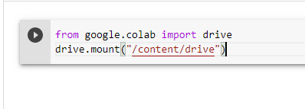
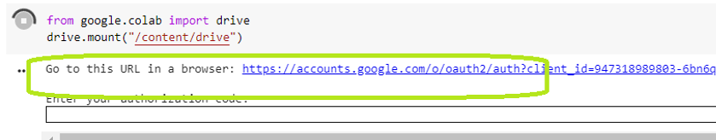
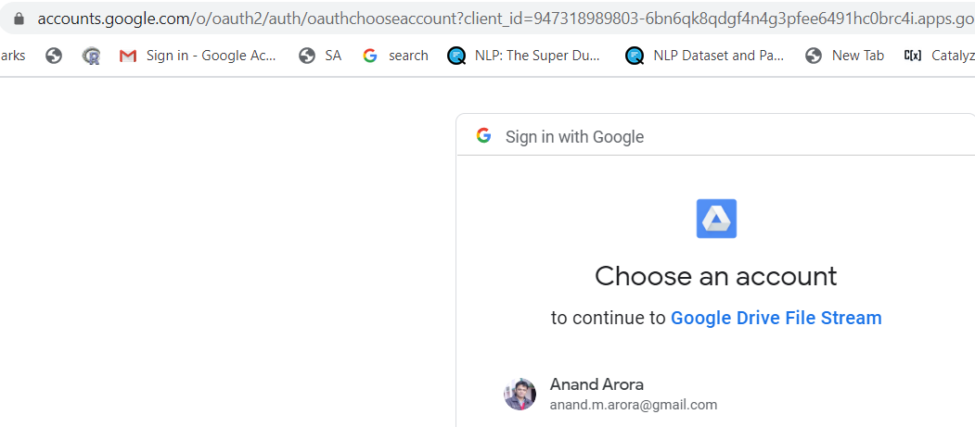
Using “Chrome browser” create a “new notebook” in “Google Colab” and “write” following lines of code
from google.colab import drive
drive.mount("/content/drive")
Press “Ctrl+ Enter” OR “Shift + Enter” OR the arrow icon on left to “execute”
Click on this URL
New browser pane opens up
If you have multiple Google accounts, the page will have list of options to choose.
Click on the Google account of where you created the “INSAID folder”.

Slide 3
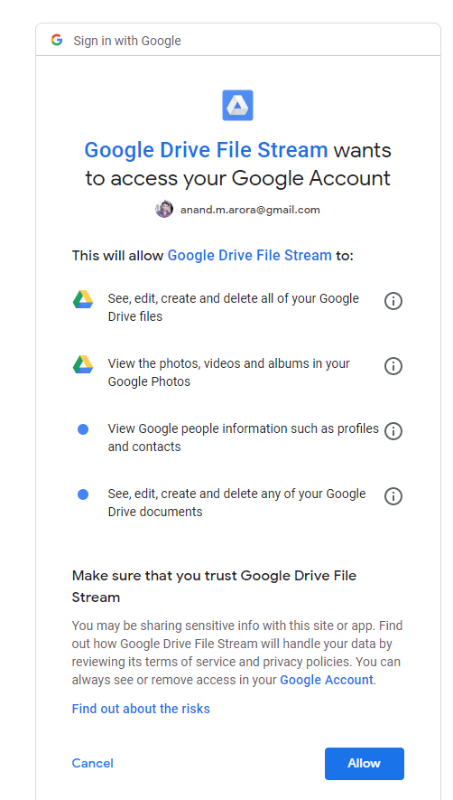
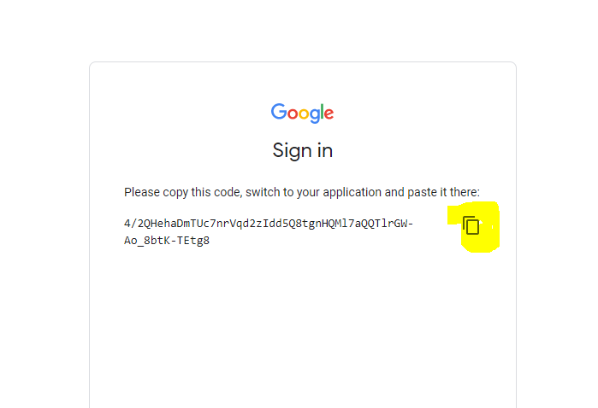
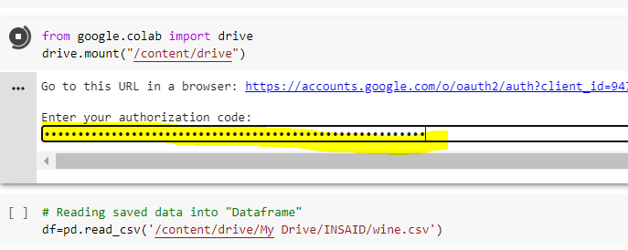
Click on “copy” icon
Paste the copied code in the “Colab Sheet”
and press “Enter”
Click “Allow”

Slide 4
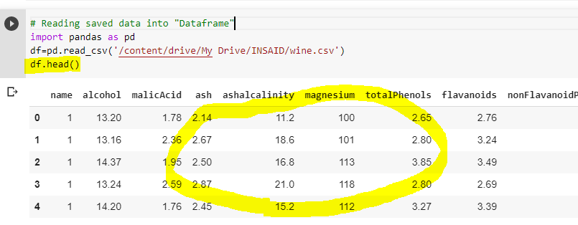
In “Google Colab” “write” following lines of code and execute:
# Reading saved data into "Dataframe"
import pandas as pd
df=pd.read_csv('/content/drive/My Drive/INSAID/wine.csv')
df.head()
We had saved the file “wine.csv” inside
INSAID folder
Data in csv file should now be visible in the dataframe “df”

